Slide 1

COMP 3962
Cloud Computing Platforms
Lab 5

Slide 2



Agenda
EBS Elaboration
Linux Basics

Slide 3
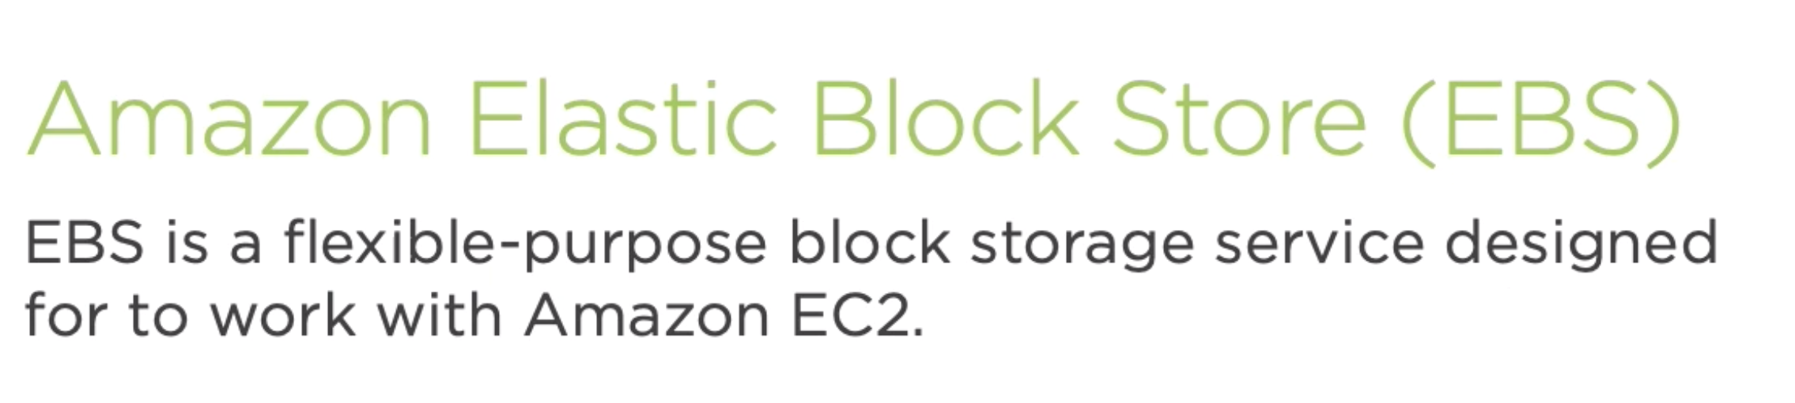
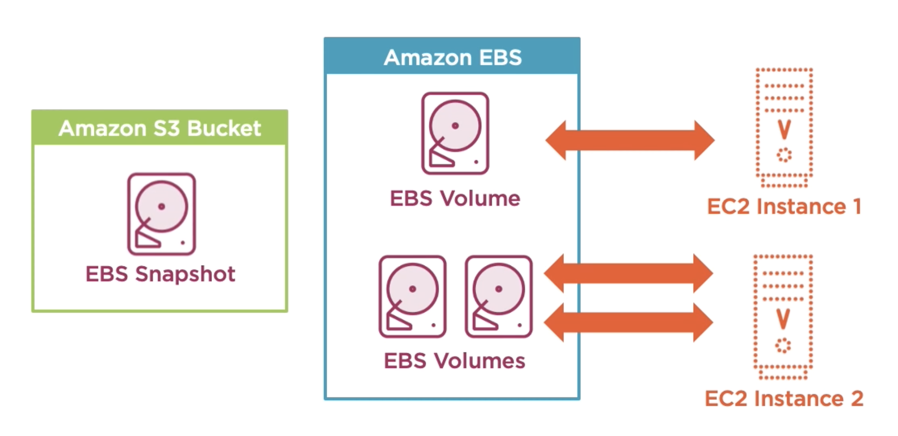

Slide 4
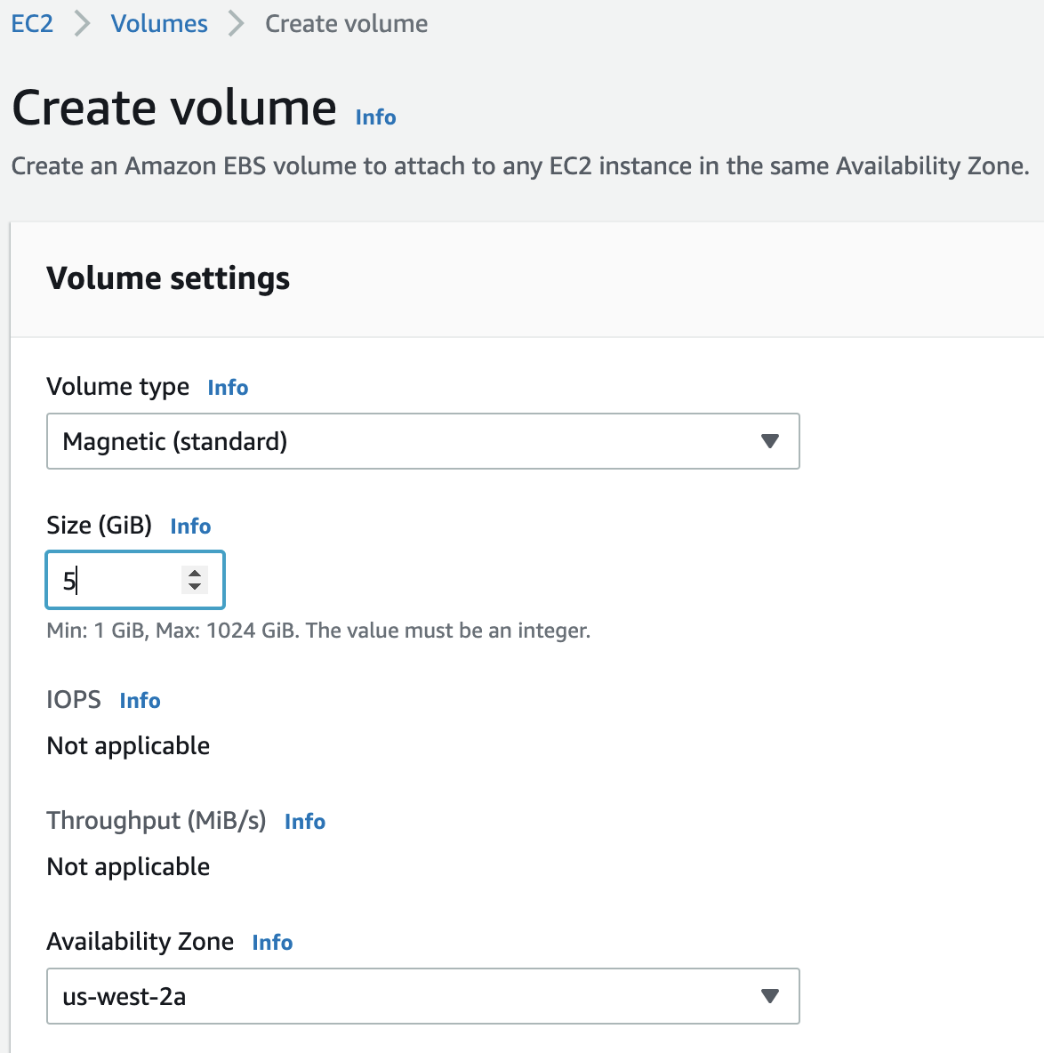
Create Volume as needed

Slide 5
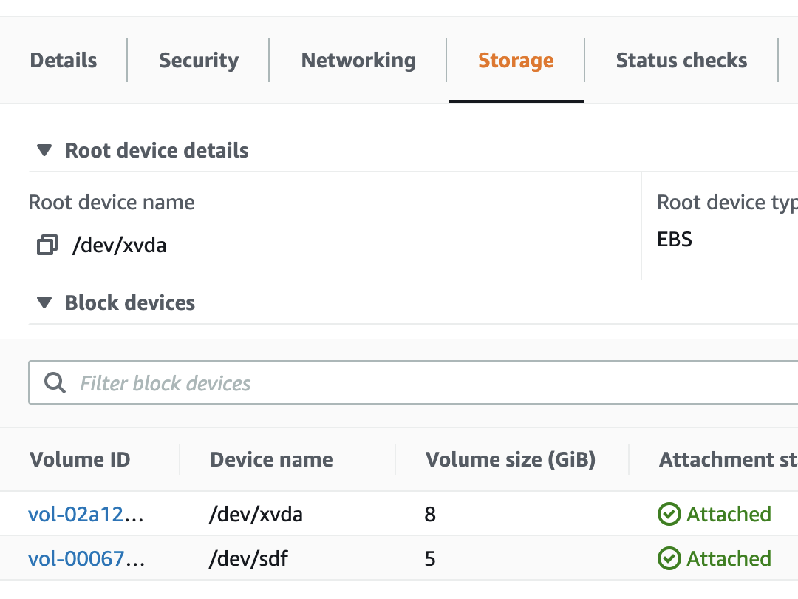

Attach Extra Volume

Slide 6
Snapshots
To create snapshots
Create snapshot on a volume
Create snapshot on an instance
To use snapshots
Create volume from snapshot
Create image from snapshot

Slide 7
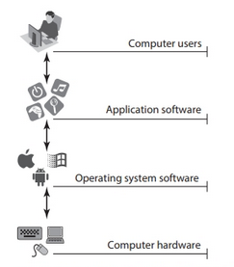
Operating System
An Operating System is a program that acts as an interface between the user of a computer and the computer hardware..
In another term, an operating system is a manager. It manages all the available resources on a computer, from the CPU, to memory, to hard disk accesses.
Tasks the operating system must perform:
  Control Hardware
  Run Applications
  Manage Data and Files
  Security

Slide 8
What is Unix?
The Unix operating system found (MIT, GE, and AT&T Bell Lab) its beginnings in MULTICS which stands for Multiplexed Operating and Computing system (Time-Sharing OS) around 1965.
A multi-task and multi-user Operating System
Developed in 1969 at AT&T’s Bell Labs by
  Ken Thompson (Unix)
  Dennis Ritchie (C)
  Douglas Mcliroy (Pipeline)
Some other variants: Solaris, SCO Unix, SunOS, FreeBSD, NetBSD, OpenBSD, BSDI

Slide 9

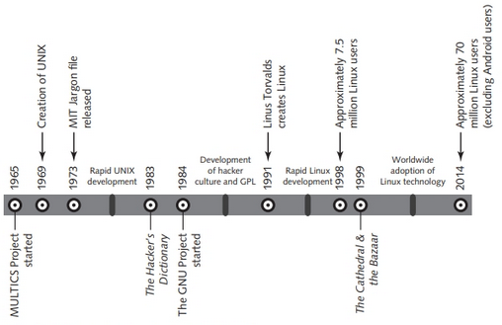
Timeline

Slide 10
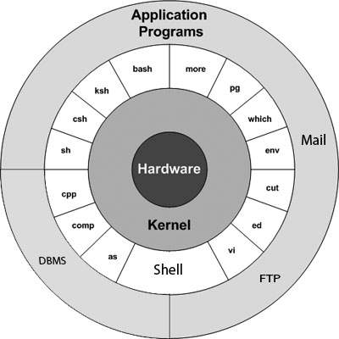
Unix Architecture
Kernel
Shell
Commands and Utilities
Files and Directories
Notes:
Kernel: The kernel is the heart of the operating system. It interacts with hardware and most of the tasks (Memory management, Process management, Device Drivers, System call and security)(Kernel Version: Major number, Minor number, Revision number).
Shell: The shell is the utility that processes your requests. When you type in a command at your terminal, the shell interprets the command and calls the program that you want.
Commands and Utilities: There are various command and utilities which you would use in your day to day activities. cp, mv, cat and grep.
Files and Directories: All data in UNIX is organized into files. All files are organized into directories. These directories are organized into a tree-like structure called the file system.

Slide 11
What is Linux?
A clone of Unix
Developed in 1991 by Linus Torvalds, a Finnish graduate student
Inspired by and replacement of Minix
Linus' Minix became Linux
Consist of
  Linux Kernel
  GNU (free software) Software
  Software Package management
  Others

Slide 12

Which Linux Distribution is better?
Ask yourself these questions (from LAH)
  Is it going to be around in 5 years?
  Is it going to stay on top of the latest security patches?
  Is it going to release updated software promptly?
  If I have problems, will the vendor talk to me?

Slide 13
Which Linux Distribution is better?
There are more than 300 Linux Distributions
  Slackware (one of the oldest, simple and stable distro.)
  Redhat
    RHEL (commercially support)
    Fedora (free)
  CentOS (free RHEL, based in England)
  SuSe ( based in German)
  Gentoo (Source code based)
  Debian (one of the few called GNU/Linux)
  Ubuntu (based in South Africa)
  Knoppix (first LiveCD distro.)
  …

Slide 14
Linux Advantages
Risk reduction
Meeting business needs
Stability and security
Flexibility for different hardware platforms
Ease of customization
Ease of obtaining support
Cost reduction

Slide 15
Linux vs. Windows
Financial Differences (Cost for Businesses)
Companies have to spend millions for licenses for ever individual windows computer
For Linux companies don’t have to spend anything
Technical Differences
Keeping up to date
Compatibility: Linux is Backward Compatible unlike Windows
Features Provided (Both support Dynamic Caching and both have multi-user support)
Application differences (No commercial word processor for Linux)
End-User Difference
System Administration

Slide 16
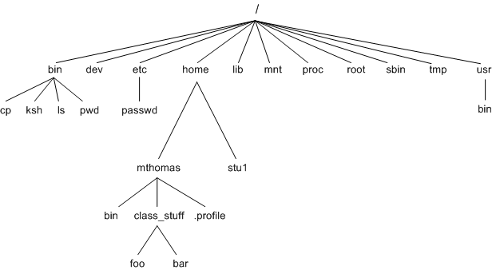
File System of Linux/Unix
A file system is a logical collection of files on a partition or disk.
A partition is a container for information and can span an entire hard drive if desired.
Everything in Unix/Linux is considered to be a file, including physical devices such as DVD-ROMs, USB devices, floppy drives, SSD, and so forth

Slide 17
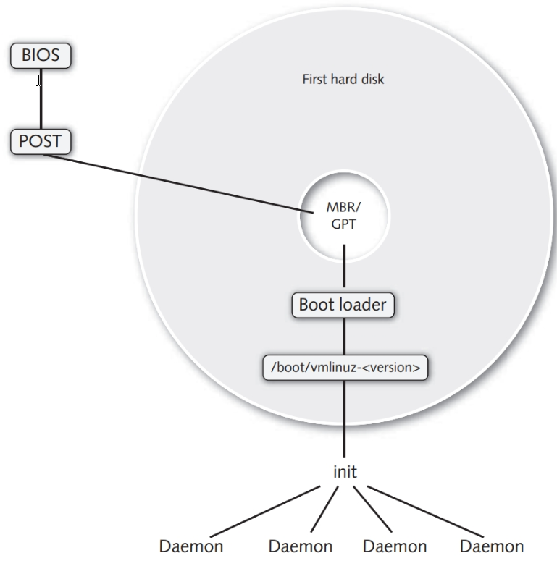
Linux Boot Process

Slide 18
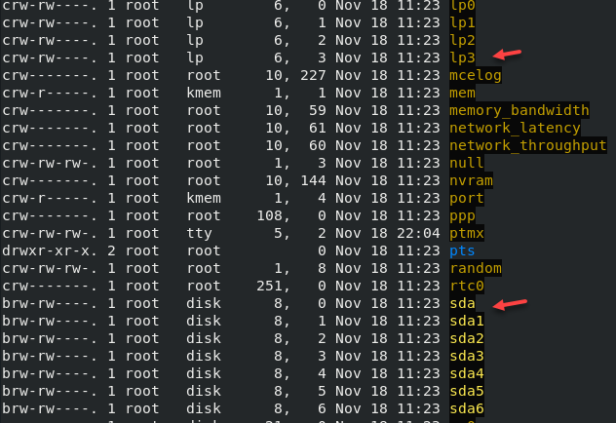
File Types in Linux
- : regular file
d : directory
c : character device file
b : block device file
s : local socket file
p : named pipe
l : symbolic link

Slide 19
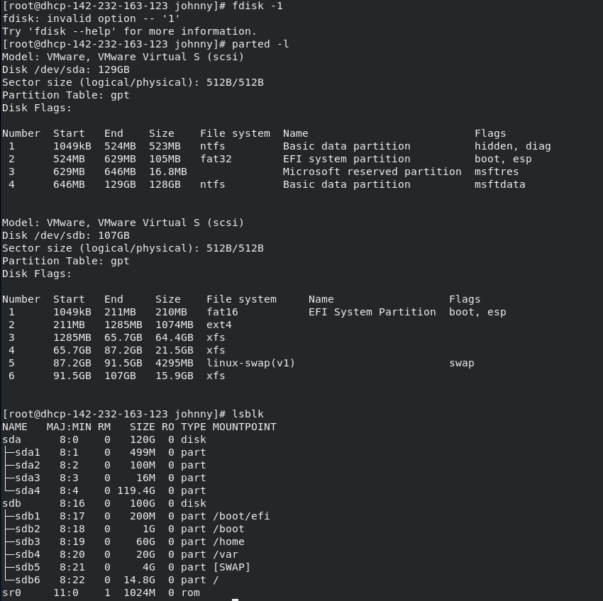
Recommended Partitioning Scheme
CentOS recommends that you create separate file systems at the following mount points:
/boot
/ (root)
/home
swap
/boot/efi or /biosboot

Slide 20
File Tree
/bin: These are the executable programs that comprise the GNU/Linux utilities.
/boot: booting the operating system
/dev: Files that represent hardware components (sr, lp, sda..)
/etc: Contains system configuration files
/home: Contains user directories and files
/lib: Contains all library files

Slide 21
File Tree
/(root): Root users’ home directory; Starting point of the directory tree
/sbin: System binary files reside here. If there is no /sbin directory on your system, these files most likely reside in /etc
/usr: The name of this directory is pronounced "user", and it generally contains application programs, libraries, and other files that are not part of the GNU/Linux system
/var: Variable data files
/tmp: Storage for temporary files which are periodically removed from the filesystem

Slide 22
Disk Partitions
Logical disk
  4 primary partitions
  Can be extended by extended partition
To display: $ fdisk –l
To partition
  $ fdisk /dev/sda
  m help
  p display partition info
  n new a partition
  d delete a partition
  l list known partition type
  t change partition id

Slide 23
Mount & umount
mount
To add a device file to Linux
Command: mount [file] [destination]
Example: mount /dev/xvdf /fileserver
Umount
To remove a device file from Linux
Command: umount [location]
Example: umount /dev/xvdf

Slide 24

Lab Time

